Slide 1
Project- Extension
Position, type, length of the thermocouples

Slide 2
A0. Design of the measuring pipe
1. 3 pipes connected in series, 4,5 m each, 4 VIP panels-length as measuring area
2. Two thicknesses of VIP will be used: 6 and 8 mm, and panels has Al foil in both sides
3. 300 mm ordinary pipe can be reduced to 200 mm
4. Dimension of the VIPs: 6mm thick, 970 mm length, 294 width
5. Dimension of the VIPs: 8mm thick, 970 mm length, XXX width
Part A
General dimensions:4600mm (measuring area)
300
1000
1000
1000
1000
300
Ordinary pipe
VIP
VIP
VIP
VIP
Ordinary pipe
4600 mm

Slide 3
Pipe 1
300
1000
1000
1000
1000
300
Section 1
Section 2
Section 3
Section 4
Ordinary pipe
VIP-6mm
VIP-6mm
VIP-6mm
VIP-6mm
Ordinary pipe
4600 mm
Position of TCs: in the middle of sections
TCX 7
TCX 6
The aim is to determine the influence of Al-foil on both sides.
TCX 1
TCX 2
TCX 3
TCX 4
TCX 5
Section 1
Section 2
Section 3
Section 4
length
TCX1, TCX2, TX3 (Supply temperature) 2 meters (80 cm out of measuring area)
TCX4, TCX5, TCX6, TX7 (3 VIP, 1 PEX, 1 mantel) 3 meters (180 cm out of measuring area)
Section 1: should be damaged
Total 7 TC

Slide 4
Pipe 2
300
1000
1000
1000
1000
300
Section 1
Section 2
Section 3
Section 4
Ordinary pipe
VIP-8mm
VIP-8mm
VIP-8mm
VIP-8mm
Ordinary pipe
4600 mm
Position of TCs: in the middle of sections
TCX 14
TCX 13
The aim is to determine the influence of VIP thickness.
TCX 8
TCX 9
TCX 10
TCX 11
TCX 12
Section 1
Section 2
Section 3
Section 4
length
TCX8, TCX9, TCX10 (Supply temperature) 2 meters (80 cm out of measuring area)
TCX11, TCX12, TCX13, TCX14 (3 VIP, 1 PEX, 1 mantel) 3 meters (180 cm out of measuring area)
Section 1: should be damaged
Total 7 TC

Slide 5
Pipe 3
2layers of VIP
300
1000
1000
1000
1000
300
Section 1
Section 2
Section 3
Section 4
Ordinary pipe
VIP-8/6mm
VIP-8/6mm
VIP-8/6mm
VIP-8/6mm
Ordinary pipe
4600 mm
Position of TCs: in the middle of sections
TCX 26
TCX 25
The aim is to determine the influence of VIP thickness.
TCX 15
TCX 16
TCX 17,18
TCX 19,20
TCX 21,22
TCX 23,24
Section 1
Section 2
Section 3
Section 4
length
TCX15 toTCX18, TCX23, TCX24 (2Supply temperature, 4 VIP)2 meters (80 cm out of measuring area)
TCX19 to TCX22, TCX25, TCX26 (4 VIP, 1 PEX, 1 mantel) 3 meters (180 cm out of measuring area)
Section 1: should be damaged
Total 12 TC

Slide 6
Total number of TC: 26 st
Thermocouples and temperature measurements
12 TC of length 2 meter
14 TC of length 3 meter
length
TCX1, TCX2, TX3 (Supply temperature) 2 meters (80 cm out of measuring area)
TCX4, TCX5, TCX6, TX7 (3 VIP, 1 PEX, 1 mantel) 3 meters (180 cm out of measuring area)
length
TCX8, TCX9, TCX10 (Supply temperature) 2 meters (80 cm out of measuring area)
TCX11, TCX12, TCX13, TCX14 (3 VIP, 1 PEX, 1 mantel) 3 meters (180 cm out of measuring area)
length
TCX15 toTCX18, TCX23, TCX24 (2Supply temperature, 4 VIP)2 meters (80 cm out of measuring area)
TCX19 to TCX22, TCX25, TCX26 (4 VIP, 1 PEX, 1 mantel) 3 meters (180 cm out of measuring area)

Slide 7
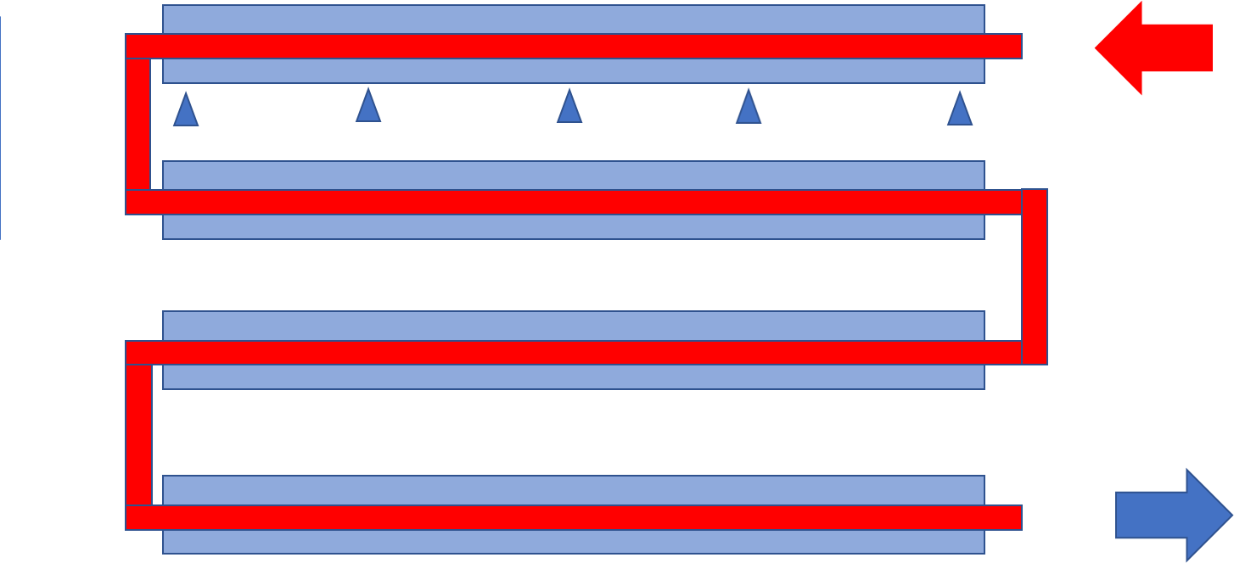
- Thermo-couples will draw out to the left and right sides of the pipes for connecting to the logger. We need at least 26 channels (13 in each logger).
Heat source
Pipe 1
Logger
Pipe 2
Logger
Pipe 3

